Slide 1
Customer segmentation on potato chips sales
Denis Thuo

Slide 2
AGENDA
Introduction​
Primary goals
​Data preparation
Interpretion
​Summary​

Slide 3
introduction
This presentation entails a strategic recommendation to Julia that is supported by data which she can then use for the upcoming category review however to do so we need to analyze the data to understand the current purchasing trends and behaviors. The client is particularly interested in customer segments and their chip purchasing behavior. Consider what metrics would help describe the customers’ purchasing behavior.

Slide 4
PRIMARY GOALS
Examine transaction data – look for inconsistencies, missing data across the data set, outliers, correctly identified category items, numeric data across all tables. If you determine any anomalies make the necessary changes in the dataset and save it. Having clean data will help when it comes to your analysis.
Examine customer data – check for similar issues in the customer data, look for nulls and when you are happy merge the transaction and customer data together so it’s ready for the analysis ensuring you save your files along the way.
Data analysis and customer segments – in your analysis make sure you define the metrics – look at total sales, drivers of sales, where the highest sales are coming from etc. Explore the data, create charts and graphs as well as noting any interesting trends and/or insights you find. These will all form part of our report to Julia.
Deep dive into customer segments – define your recommendation from your insights, determine which segments we should be targeting, if packet sizes are relative and form an overall conclusion based on your analysis.

Slide 5
Data preparation
DATA QUALITY FRAMEWORK
Hi there,
According to the task assigned, I reviewed the potato chips dataset in order to ensure that the data quality is standard and conforms to the data quality framework and below are results.
Transactions Table
This table contains inaccurate records in the first column “DATE”
Mitigation: Convert all the rows in the column into date format
It contains outliers in the column “Product quantity” i.e., 200 is unrelatable number to the dataset.
Mitigation: Delete all rows with outlier values
No other quality issues as all the standards are optimum
Timeliness
Completeness
Validity
Uniqueness
Consistency
Customer Demographics Table
No major quality issues all the checks are optimum
Timeliness
Completeness
Validity
Uniqueness
Consistency
Accuracy

Slide 6
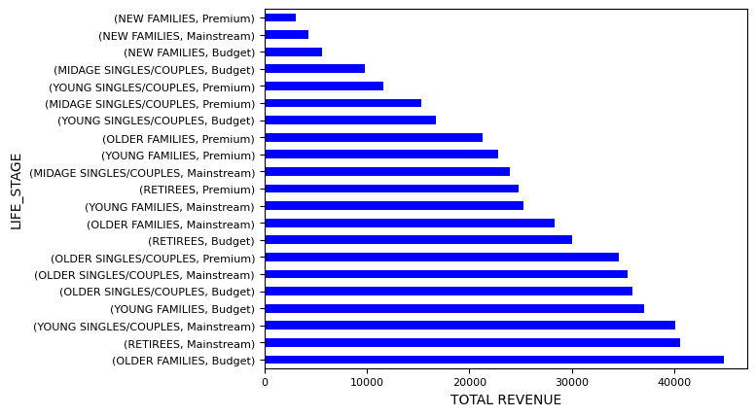
customer OF FOCUS

Slide 7
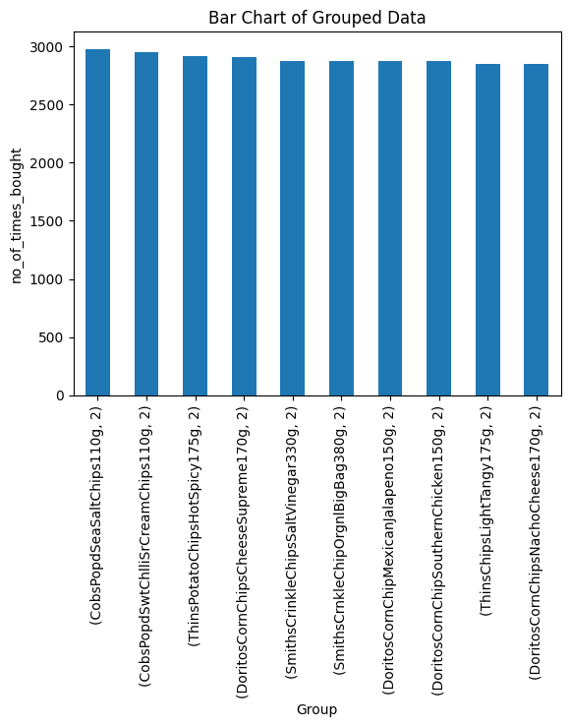
Most bou products packs

Slide 8
summary
Sales have mainly been due to Budget - older families, Mainstream - young singles/couples, and Mainstream - retirees shoppers. We found that the high spend in chips for mainstream young singles/couples and retirees is due to there being more of them than other buyers. Mainstream, midage and young singles and couples are also more likely to pay more per packet of chips. This is indicative of impulse buying behaviour. We’ve also found that Mainstream young singles and couples are 23% more likely to purchase Tyrrells chips compared to the rest of the population. The Category Manager may want to increase the category’s performance by off-locating some Tyrrells and smaller packs of chips in discretionary space near segments where young singles and couples frequent more often to increase visibilty and impulse behaviour. Quantium can help the Category Manager with recommendations of where these segments are and further help them with measuring the impact of the changed placement. We’ll work on measuring the impact of trials in the next task and putting all these together in the third task.

Slide 9
THANK YOU
Denis Kamau Tuo
tuodenis97@mail.com

